Slide 1
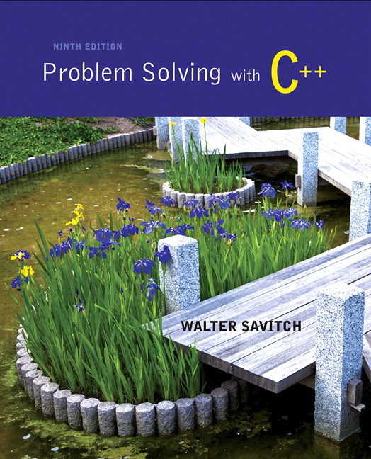
Problem Solving with C++ by Walter Savitch

Slide 2
Chapter 1
Introduction to Computers and
C++ Programming

Slide 3
Overview
1.1 Computer Systems
1.2 Programming and Problem Solving
1.3 Introduction to C++
1.4 Testing and Debugging

Slide 4
1.1
Computer Systems

Slide 5
Computer Systems
A computer program is…
A set of instructions for a computer to follow
Computer software is …
The collection of programs used by a computer
Includes:
Editors
Translators
System Managers

Slide 6
Hardware
Three main classes of computers
PCs (Personal Computer)
Relatively small used by one person at a time
Workstation
Larger and more powerful than a PC
Mainframe
Still larger
Requires support staff
Shared by multiple users

Slide 7
Networks
A number of computers connected to share resources
Share printers and other devices
Share information

Slide 8
Computer Organization
Five main components
Input devices
Allows communication to the computer
Output devices
Allows communication to the user
Processor (CPU)
Main memory
Memory locations containing the running program
Secondary memory
Permanent record of data often on a disk
Display 1.1

Slide 9
Computer Memory
Main Memory
Long list of memory locations
Each contains zeros and ones
Can change during program execution
Binary Digit or Bit
A digit that can only be zero or one
Byte
Each memory location has eight bits
Address
Number that identifies a memory location

Slide 10
Larger Data Items
Some data is too large for a single byte
Most integers and real numbers are too large
Address refers to the first byte
Next few consecutive bytes can store the additional bits for larger data
Display 1.2

Slide 11
Data or Code?
‘A’ may look like 01000001
65 may look like 01000001
An instruction may look like 01000001
How does the computer know the meaning of 01000001?
Interpretation depends on the current instruction
Programmers rarely need to be concerned with this problem.
Reason as if memory locations contain letters and numbers rather than zeroes and ones

Slide 12
Secondary Memory
Main memory stores instructions and data while a program is running.
Secondary memory
Stores instructions and data between sessions
A file stores data or instructions in secondary memory

Slide 13
Secondary Memory Media
A computer might have any of these types of secondary memory
Hard disk
Fast
Fixed in the computer and not normally removed
Floppy disk
Slow
Easily shared with other computers
Compact disk
Slower than hard disks
Easily shared with other computers
Can be read only or re-writable

Slide 14
Memory Access
Random Access
Usually called RAM
Computer can directly access any memory location
Sequential Access
Data is generally found by searching through other items first
More common in secondary memory

Slide 15
The Processor
Typically called the CPU
Central Processing Unit
Follows program instructions
Typical capabilities of CPU include: add subtract multiply divide move data from location to location

Slide 16
Computer Software
The operating system
Allows us to communicate with the computer
Is a program
Allocates the computer’s resources
Responds to user requests to run other programs
Common operating systems include…
UNIX Linux DOS Windows Macintosh VMS

Slide 17
Computer Input
Computer input consists of
A program
Some data
Display 1.3

Slide 18
High-level Languages
Common programming languages include … C C++ Java Pascal Visual Basic FORTRAN Perl PHP Lisp Scheme Ada C# Python
These high – level languages
Resemble human languages
Are designed to be easy to read and write
Use more complicated instructions than the CPU can follow
Must be translated to zeros and ones for the CPU to execute a program

Slide 19
Low-level Languages
An assembly language command such as ADD X Y Z might mean add the values found at x and y in memory, and store the result in location z.
Assembly language must be translated to machine language (zeros and ones) 0110 1001 1010 1011
The CPU can follow machine language

Slide 20
Compilers
Translate high-level language to machine language
Source code
The original program in a high level language
Object code
The translated version in machine language
Display 1.4

Slide 21
Linkers
Some programs we use are already compiled
Their object code is available for us to use
For example: Input and output routines
A Linker combines
The object code for the programs we write and
The object code for the pre-compiled routines into
The machine language program the CPU can run
Display 1.5

Slide 22
History Note
First programmable computer
Designed by Charles Babbage
Began work in 1822
Not completed in Babbage’s life time
First programmer
Ada Augusta, Countess of Lovelace
Colleague of Babbage

Slide 23
Section 1.1 Conclusion
Can you…
List the five main components of a computer?
List the data for a program that adds two numbers?
Describe the work of a compiler?
Define source code? Define object code?
Describe the purpose of the operating system?

Slide 24
1.2
Programming and Problem-Solving

Slide 25
Algorithms
Algorithm
A sequence of precise instructions that leads to a solution
Program
An algorithm expressed in a language the computer can understand
Display 1.6

Slide 26
Program Design
Programming is a creative process
No complete set of rules for creating a program
Program Design Process
Problem Solving Phase
Result is an algorithm that solves the problem
Implementation Phase
Result is the algorithm translated into a programming language

Slide 27
Problem Solving Phase
Be certain the task is completely specified
What is the input?
What information is in the output?
How is the output organized?
Develop the algorithm before implementation
Experience shows this saves time in getting your program to run.
Test the algorithm for correctness

Slide 28
Implementation Phase
Translate the algorithm into a programming language
Easier as you gain experience with the language
Compile the source code
Locates errors in using the programming language
Run the program on sample data
Verify correctness of results
Results may require modification of the algorithm and program
Display 1.7

Slide 29
Object Oriented Programming
Abbreviated OOP
Used for many modern programs
Program is viewed as interacting objects
Each object contains algorithms to describe its behavior
Program design phase involves designing objects and their algorithms

Slide 30
OOP Characteristics
Encapsulation
Information hiding
Objects contain their own data and algorithms
Inheritance
Writing reusable code
Objects can inherit characteristics from other objects
Polymorphism
A single name can have multiple meanings depending on its context

Slide 31
Software Life Cycle
Analysis and specification of the task (problem definition)
Design of the software (object and algorithm design)
Implementation (coding)
Maintenance and evolution of the system
Obsolescence

Slide 32
Section 1.2 Conclusion
Can you…
Describe the first step to take when creating a program?
List the two main phases of the program design process?
Explain the importance of the problem-solving phase?
List the steps in the software life cycle?

Slide 33
1.3
Introduction to C++

Slide 34
Introduction to C++
Where did C++ come from?
Derived from the C language
C was derived from the B language
B was derived from the BCPL language
Why the ‘++’?
++ is an operator in C++ and results in a cute pun

Slide 35
C++ History
C developed by Dennis Ritchie at AT&T Bell Labs in the 1970s.
Used to maintain UNIX systems
Many commercial applications written in c
C++ developed by Bjarne Stroustrup at AT&T Bell Labs in the 1980s.
Overcame several shortcomings of C
Incorporated object oriented programming
C remains a subset of C++

Slide 36
A Sample C++ Program
A simple C++ program begins this way #include <iostream> using namespace std; int main() {
And ends this way return 0; }
Display 1.8

Slide 37
Explanation of code (1/5)
Variable declaration line int number_of_pods, peas_per_pod, total_peas;
Identifies names of three variables to name numbers
int means that the variables represent integers

Slide 38
Explanation of code (2/5)
Program statement cout << “Press return after entering a number.\n”;
cout (see-out) used for output to the monitor
“<<“ inserts “Press…a number.\n” in the data bound for the monitor
Think of cout as a name for the monitor
“<<“ points to where the data is to end up
‘\n’ causes a new line to be started on the monitor

Slide 39
Explanation of code (3/5)
Program statement cin >> number_of_pods;
cin (see-in) used for input from the keyboard
“>>” extracts data from the keyboard
Think of cin as a name for the keyboard
“>>” points from the keyboard to a variable where the data is stored

Slide 40
Explanation of code (4/5)
Program statement total_peas = number_of_pods * peas_per_pod;
Performs a computation
‘*’ is used for multiplication
‘=‘ causes total_peas to get a new value based on the calculation shown on the right of the equal sign

Slide 41
Explanation of code (5/5)
Program statement cout << number_of_pods;
Sends the value of variable number_of_pods to the monitor

Slide 42
Program Layout (1/3)
Compiler accepts almost any pattern of line breaks and indentation
Programmers format programs so they are easy to read
Place opening brace ‘{‘ and closing brace ‘}’ on a line by themselves
Indent statements
Use only one statement per line

Slide 43
Program Layout (2/3)
Variables are declared before they are used
Typically variables are declared at the beginning of the program
Statements (not always lines) end with a semi-colon
Include Directives #include <iostream>
Tells compiler where to find information about items used in the program
iostream is a library containing definitions of cin and cout

Slide 44
Program Layout (3/3)
using namespace std;
Tells the compiler to use names in iostream in a “standard” way
To begin the main function of the program
int main() {
To end the main function return 0; }
Main function ends with a return statement

Slide 45
Running a C++ Program
C++ source code is written with a text editor
The compiler on your system converts source code to object code.
The linker combines all the object code into an executable program.

Slide 46
C++11
C++11 (formerly known as C++0x) is the most recent version of the standard of the C++ programming language.
Approved on August 12, 2011 by the International Organization for Standardization.
C++11 language features are not supported by older compilers
Check the documentation with your compiler to determine if special steps are needed to compile C++11 programs
e.g. with g++, use extra flags of –std=c++11

Slide 47
Run a Program
Obtain code in Display 1.10
Compile the code
Fix any errors the compiler indicates and re-compile the code
Run the program
Now you know how to run a program on your system
Display 1.10

Slide 48
Section 1.3 Conclusion
Can you…
Describe the output of this line? cout << “C++ is easy to understand.”;
Explain what this line does? cin >> peas_per_pod;
Explain this? #include <iostream>

Slide 49
1.4
Testing and Debugging

Slide 50
Testing and Debugging
Bug
A mistake in a program
Debugging
Eliminating mistakes in programs
Term used when a moth caused a failed relay on the Harvard Mark 1 computer. Grace Hopper and other programmers taped the moth in logbook stating: “First actual case of a bug being found.”

Slide 51
Program Errors
Syntax errors
Violation of the grammar rules of the language
Discovered by the compiler
Error messages may not always show correct location of errors
Run-time errors
Error conditions detected by the computer at run-time
Logic errors
Errors in the program’s algorithm
Most difficult to diagnose
Computer does not recognize an error

Slide 52
Section 1-4 Conclusion
Can you…
Describe the three kinds of program errors?
Tell what kind of errors the compiler catches?
What kind of error is produced if you forget a punctuation symbol such as a semi-colon?
Tell what type of error is produced when a program runs but produces incorrect results?

Slide 53
Chapter 1 -- End

Slide 54
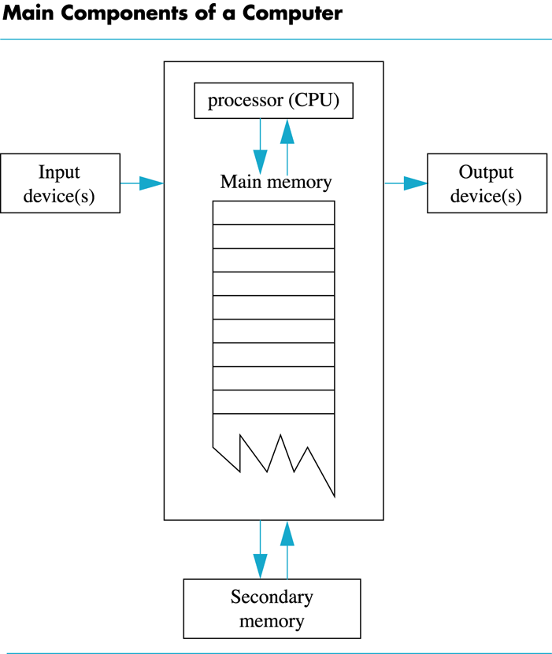
Display 1.1
Back
Next

Slide 55
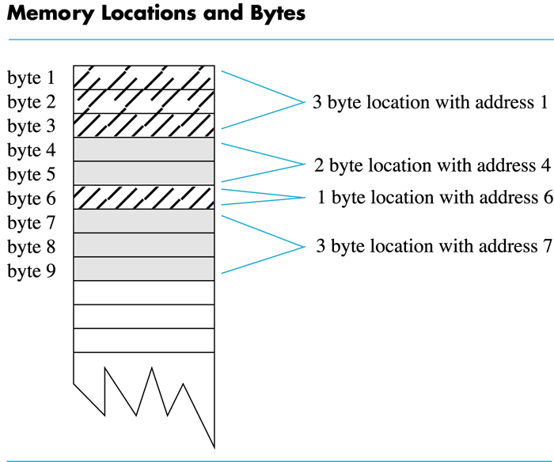
Display 1.2
Back
Next

Slide 56
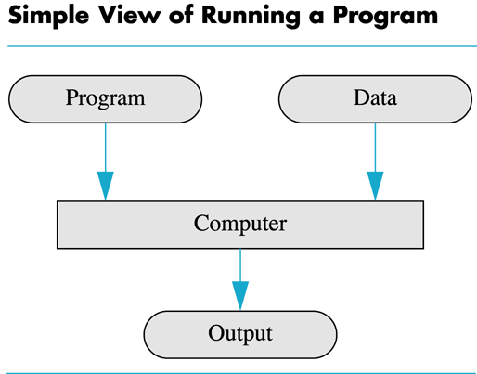
Display 1.3
Back
Next

Slide 57
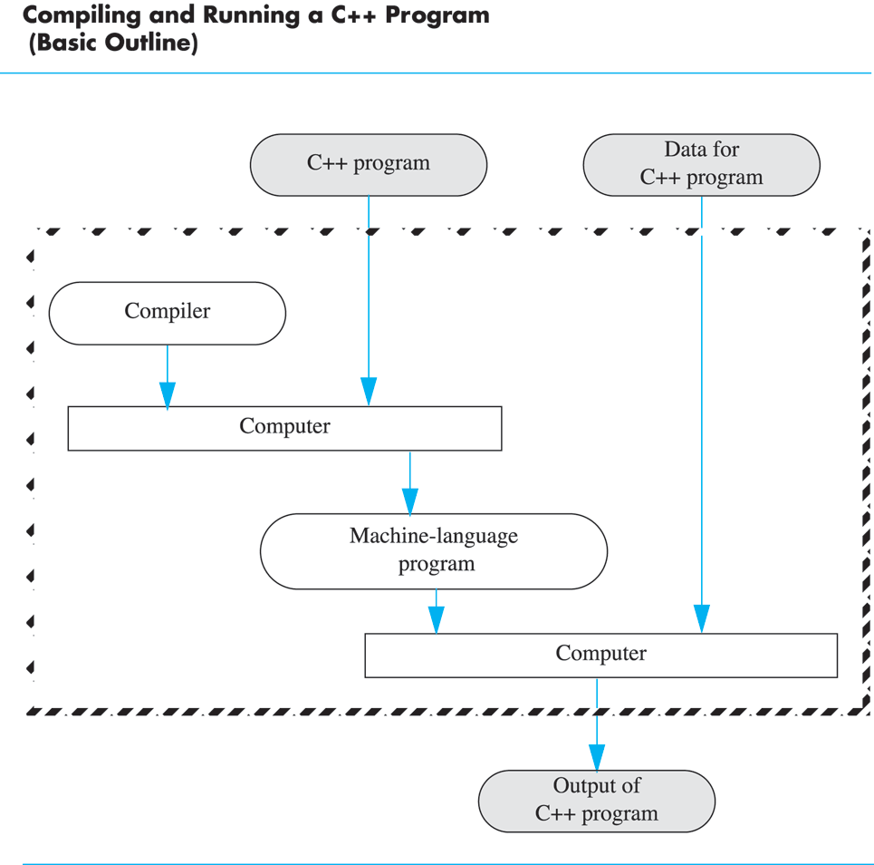
Display 1.4
Back
Next

Slide 58
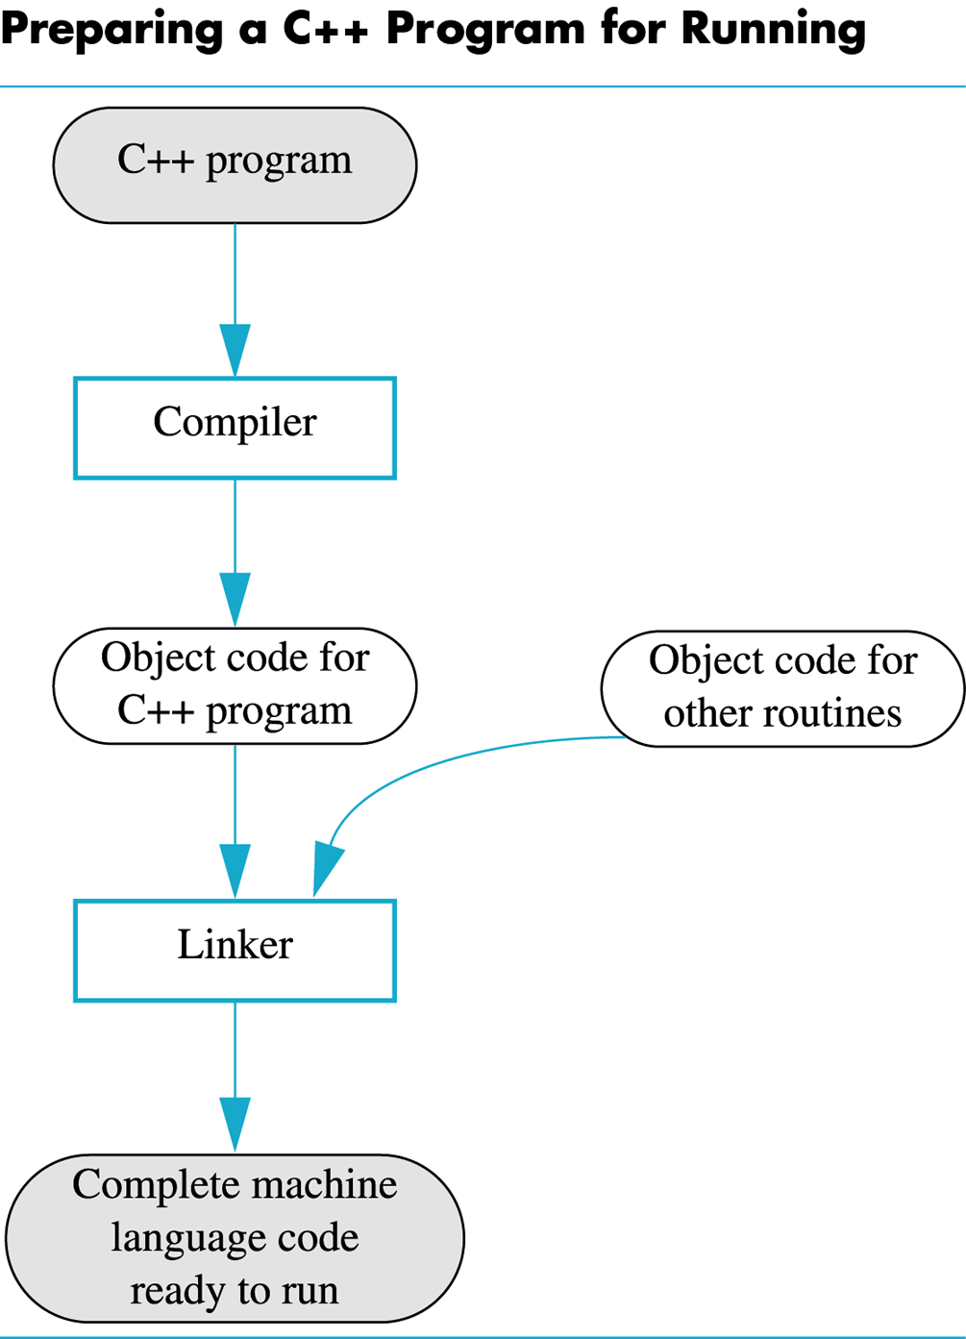
Display 1.5
Back
Next

Slide 59
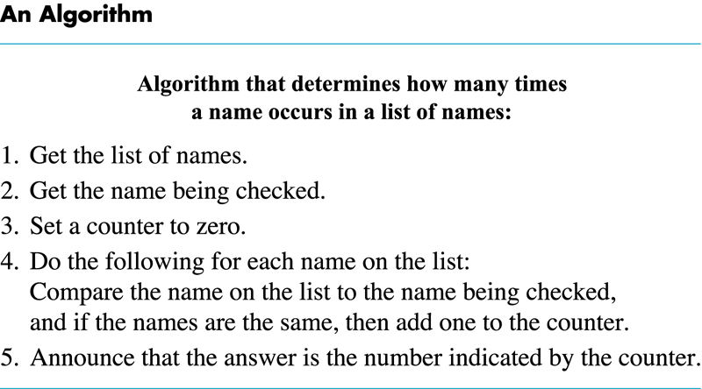
Display 1.6
Back
Next

Slide 60
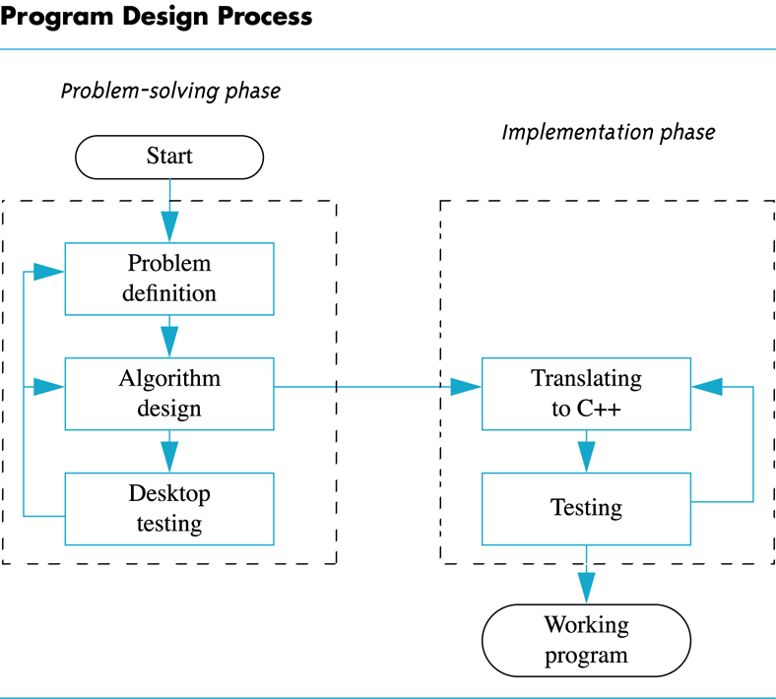
Display 1.7
Back
Next

Slide 61
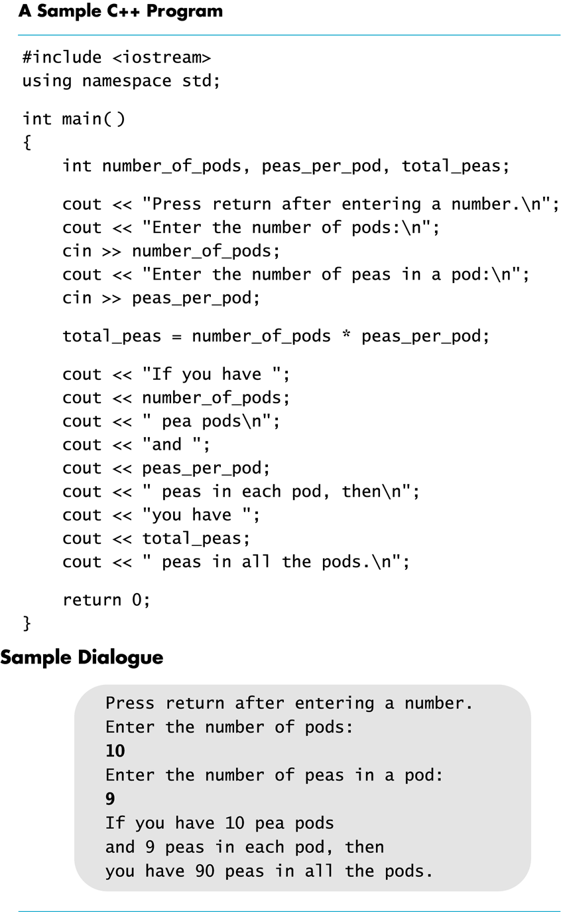
Display 1.8
Back
Next

Slide 62
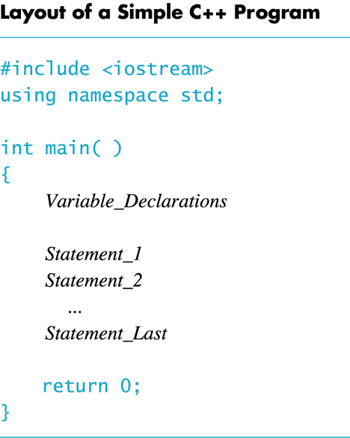
Display 1.9
Back
Next

Slide 63
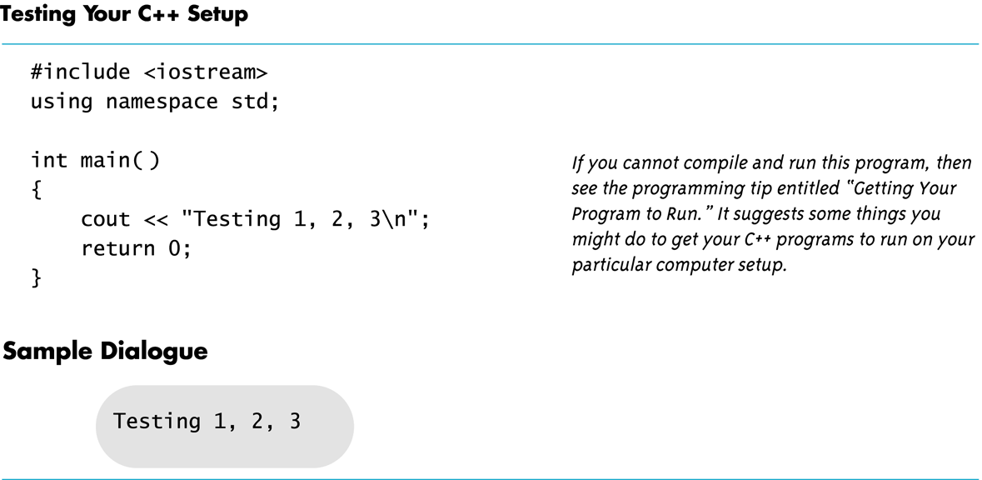
Display 1.10
Back
Next

